Slide 1
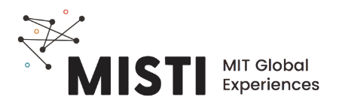
Tipos de Polímeros

Slide 2
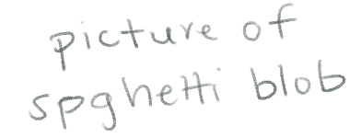
Polímeros são longos e emaranhados
Mas, com paciência, você pode desembaraçar os fios do macarrão vagarosamente
Lembre-se, polímeros são moléculas longas como espaguete. A fricção entre os fios do macarrão (ou cadeias) reduz a mobilidade de cada cadeia
Notes:
They are not chemically bonded
If you are patient enough you can unentangle them
The resistance to entanglement is what gives polymers their interesting properties

Slide 3
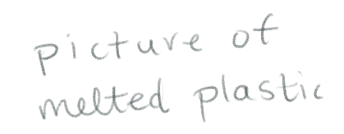
Esse tipo de polímero é chamado de termoplástico
Termoplástico
Cadeias emaranhadas mas não ligadas
Se funde em altas temperaturas
Pode se dissolver em certos líquidos
Rígido à temperatura de uso
Notes:
Thermoplastic: entangled but not chemically linked
If you heat it up, the chains become more mobile and easily slow past each other
Becomes something like a liquid
Melts at high temperatures but it hardens back as soon as you cool them back to the original temperature
These polymers can also dissolve in certain liquids and become a solution just like when you dissolve salt in water
You can no longer see the salt grains

Slide 4
Sem dissolução e fusão!
Criação de ligações químicas entre as longas cadeias
Termofixo
Cadeias ligadas quimicamente
Não se dissolve em nenhum líquido (mas pode inchar)
Um grande novelo. Os fios se quebram ao invés de se desemaranharem
Não se funde
Notes:
What if you dont want it to dissolve or melt
When you overcook past and dont add any oil it congeals into a biiiig blob
We can do this with a polymer and now it is called a thermoset
A thermoset has chemical bonds (connections) among the chains
Because of this, if you heat up the chains are not mobile anymore, so it does not become a liquid -> IT BUUURNS
Also, it does not dissolve either
It might even swell

Slide 5
As principais classes de polímeros
Elastômero
Termofixo
Termoplástico
Cadeias ligadas quimicamente
Cadeias ligadas quimicamente
Cadeias emaranhadas mas não ligadas
Não se funde
Incha em solventes
Se funde
Se dissolve em solventes
Notes:
Those as the 2 main kinds of polymers, but there is another class: elastomer
IT is pretty similar to a thermoset, but it is stretchy
Both of them are crosslinked, so they will sell and not melt

Slide 6
Rígido, flexível, ou elástico?
Elastômero
Termofixo
Termoplástico
Cadeias ligadas quimicamente
Cadeias ligadas quimicamente
Cadeias emaranhadas mas não ligadas
Elástico
Rígido
Notes:
Usually elastomers are elastic and the other 2 are stiffer

Slide 7
Estrutura química determina as propriedades
Elastômero
Termofixo
Termoplástico
Cadeias ligadas quimicamente
Cadeias ligadas quimicamente
Cadeias emaranhadas mas não ligadas
Temperatura de transição vítrea T_{g}
Rígido e vítreo
Flexível e elástico
Notes:
Elastomers are more flexible bc their Tg are lower than room temperature
Tg is the glass transition temperature
It is the point at which the polymer goes from a state that is hard and brittle like glass (you can actually crack it like glass) to a soft/elastic state
This is because the chains loose mobility and jam together below Tg. Above Tg, they gain mobility and the material becomes more flexible

Slide 8
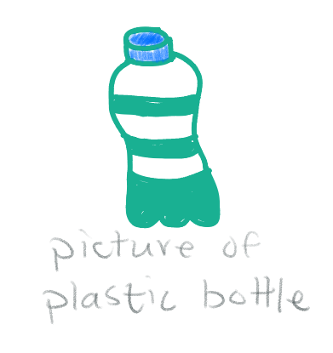
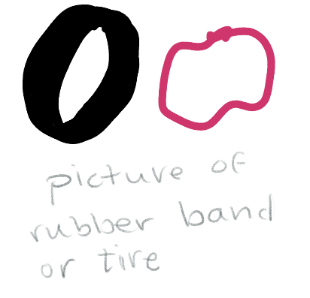
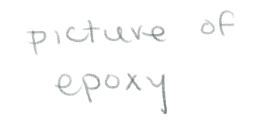
Estrutura química determina as propriedades
Elastômero
Termofixo
Termoplástico
Notes:
Rubber bands: room temperature is above Tg -> very flexible and stretchy
Epoxy/Glue
As soon as you pour it, the chains create crosslinks and room temperature is below Tg
So, the material is stiffer
Plastic bottles
Room temperature is below Tg, so they are stiff
If you heat them up enough they melt and you can recycle them
It is easier to recycle thermoplastics than the ones with permanent crosslinks

Slide 9
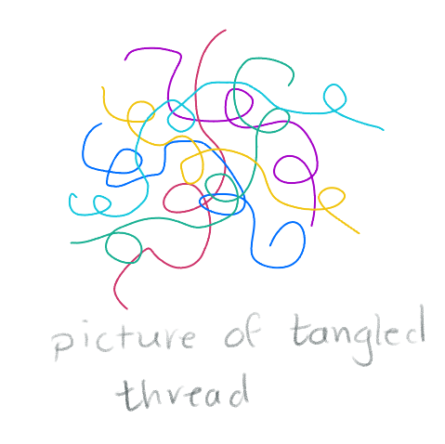
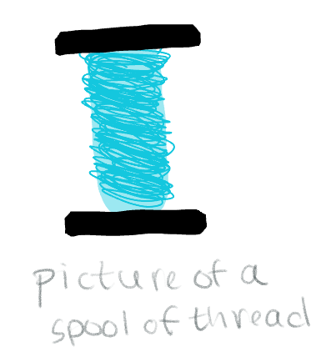
Como as longas cadeias se arranjam?
Notes:
Usually in a material, the chains arrange themselves in a very particular way
Which way do you think the chains are arranged in a material? (MAke them pick one or another or both)

Slide 10
Como os polímeros são a nível molecular?
Amorfo
Cristalino
Semi-Cristalino
Notes:
IF you picked messy: you are right in some cases! It is called amorphous
Disorded, chaotically distributed
If you picked ordered: you are right in some cases! It is called crystalline
This is not really a realistic case -> very hard to make it 100% crystalline
This is because there are always some crystalline regions and amorphous regions
And if you said both: you’re also right -> semi-crystalline
This is what happens a lot of times
The way the chains are arranged influence a lot their properties
The higher the crystallinity, the higher the Tg

